Slide 1
Cloud Computing
Amazon Web Services - introduction
Keke Chen

Slide 2
Agenda
Approaching cloud computing via a real example: Amazon Web Services (AWS)
  You can get quick hands-on experience
  Have an understanding of CC from the user’s point of view
Then explore the internal of a cloud
  Internal Architecture
  Enabling technologies
    Virtualization
    Web services

Slide 3
Infrastructure as a service
Users can ask for
  Computing nodes (servers)
  Storage
  Networking (between nodes)

Slide 4
AWS: Infrastructure as a service
Computing
  Elastic Compute Cloud (EC2)
Storage
  Simple Storage Services (S3)
  Elastic Block Stores (EBS)
  Glaciar
  DynamoDB
Other services
  Simple Queue Service

Slide 5
EC2
A typical example of utility computing
functionality:
  launch instances with a variety of operating systems (windows/linux)
  load them with your custom application environment (customized AMI)
  Full root access to a blank Linux machine
  manage your network’s access permissions
  run your image using as many or few systems as you desire (scaling up/down)

Slide 6
Backyard…
Powered by Xen – Virtual Machine
  Different from Vmware & VPC
    - high performance
  Hardware contributions by Intel (VT-x/Vanderpool) and AMD (AMD-V)
  Supports “Live Migration” of a virtual machine between hosts
  We will dedicate one class to Xen...

Slide 7
Amazon Machine Images
Public AMIs: Use pre-configured, template AMIs to get up and running immediately. Choose from Fedora, Movable Type, Ubuntu configurations, and more
Private AMIs: Create an Amazon Machine Image (AMI) containing your applications, libraries, data and associated configuration settings
Paid AMIs: Set a price for your AMI and let others purchase and use it (Single payment and/or per hour)
  AMIs with commercial DBMS

Slide 8
Normal way to use EC2
For web applications
  Run your base system in minimum # of VMs
  Monitoring the system load (user traffic)
  Load is distributed to VMs
  If over some threshold → increase # of VMs
  If lower than some thresholds → decrease # of VMs
For data intensive analysis
  Estimate the optimal number of nodes (tricky!)
  Load data
  Start processing

Slide 9
Tools (most are for web apps)
Elastic Block Store: network-attached persistent storage, can be attached to each VM instance
Elastic IP address: programmatically remap public IP to any instance
Virtual private cloud: bridge private cloud and AWS resources
CloudWatch: monitoring EC2 resouces
Auto Scaling: conditional scaling
Elastic load balancing: automatically distribute incoming traffic across instances

Slide 10
Type of instances
Standard instances (micro, small, large, extra)
  E.g., small: 2GB Memory, 1EC2 Compute Unit (Xeon processor?), some GBs of instance/EBS storage (i.e., root volume)
High-CPU instances
  More CPU with same amount of memory

Slide 11
Pricing
Check the website

Slide 12
Amazon machine images(AMIs)
Virtual machine images
When users ask for a specific system
  AWS loads the corresponding AMI and creates the virtual machine (VM)
The user access the VM instance, no different from accessing a real remote server
AMIs cover most common systems
  Linux distributions
  Windows server

Slide 13
AMIs with special software
IBM DB2, Informix Dynamic Server, Lotus Web Content Management, WebSphere Portal Server
MS SQL Server, IIS/Asp.Net
Hadoop
Open MPI
Apache web server
MySQL
Oracale 11g
…

Slide 14
Access methods
Web interface
Command line
Programming Interface
  E.g., boto python library

Slide 15
Simple Storage Service (S3)
Write,read,delete objects 0byte-5TB, single PUT <5GB
Namespace: two levels: buckets, keys
Accessible using URLs

Slide 16



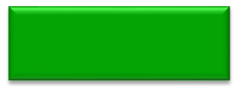
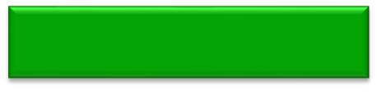
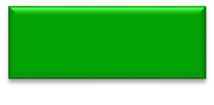
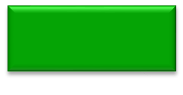

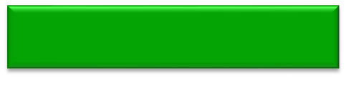
S3 namespace
Amazon S3
bucket
bucket
object
object
object
object
bucket
object
object

Slide 17


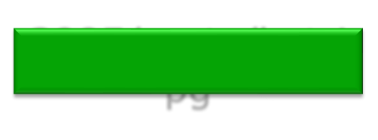

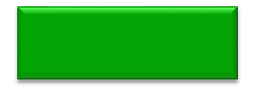

Amazon S3
mculver-images
media.mydomain.com
Beach.jpg
2005/party/hat.jpg
img1.jpg
img2.jpg
public.blueorigin.com
index.html
img/pic1.jpg

Slide 18
Accessing objects
Bucket: keke-images, key: jpg1, object: a jpg image
  accessible with
  https://keke-images.s3.amazonaws.com/jpg1
mapping your subdomain to S3
  with DNS CNAME configuration
  e.g. media.yourdomain.com → media.yourdomain.com.s3.amazonaws.com/

Slide 19
Access control
Access log
Authorization
  ACL: AWS users, users identified by email, any user …
Digital signature to ensure integrity
Encrypted access: https

Slide 20
Pricing
Check the website

Slide 21
Elastic Block Store
An EBS volume is a virtual disk of a fixed size with a block read/write interface. It can be mounted as a filesystem on a running EC2 instance where it can be updated incrementally. Unlike an instance store, an EBS volume is persistent.
(Compare to an S3 object, which is essentially a file that must be accessed in its entirety.)
Fundamental operations:
  CREATE a new volume (1GB-1TB)
  COPY a volume from an existing EBS volume or S3 object.
  MOUNT on one instance at a time.
  SNAPSHOT current state to an S3 object.

Slide 22
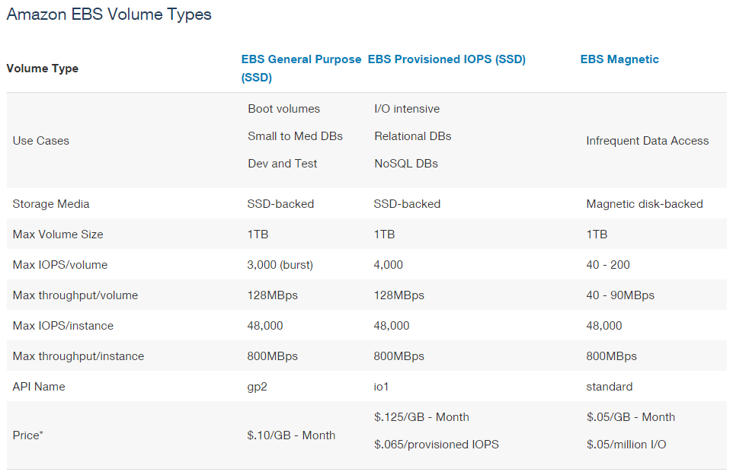

Slide 23
EBS is approx. 3x more expensive by volume and 10x more expensive by IOPS than S3.

Slide 24
Use Glacier for Cold Data
Glacier is structured like S3: a vault is a container for an arbitrary number of archives. Policies, accounting, and access control are associated with vaults, while an archive is a single object.
However:
  All operations are asynchronous and notified via SMS.
  Vault listings are updated once per day.
  Archive downloads may take up to four hours.
  Only 5% of total data can be accessed in a given month.
Pricing:
  Storage: $0.01 per GB-month
  Operations: $0.05 per 1000 requests
  Data Transfer: Like S3, free within AWS.
S3 Policies can be set up to automatically move data into Glacier.

Slide 25
Durability
Amazon claims about S3:
  Amazon S3 is designed to sustain the concurrent loss of data in two facilities, e.g. 3+ copies across multiple available domains.
  99.999999999% durability of objects over a given year.
Amazon claims about EBS:
  Amazon EBS volume data is replicated across multiple servers in an Availability Zone to prevent the loss of data from the failure of any single component.
  Volumes <20GB modified data since last snapshot have an annual failure rate of 0.1% - 0.5%, resulting in complete loss of the volume.
  Commodity hard disks have an AFR of about 4%.
Amazon claims about Glacier is the same as S3:
  Amazon S3 is designed to sustain the concurrent loss of data in two facilities, e.g. 3+ copies across multiple available domains PLUS periodic internal integrity checks.
  99.999999999% durability of objects over a given year.
Beware of oversimplified arguments about low-probability events!

Slide 26
DynamoDB
Simple table like storage
  Weak schema
  Back-end: a key-value store
Features
  Scalable: Dynamo architecture
  Reliable
    Replicas over multiple data centers
  Speed
    Fast, single-digit milliseconds
  Secure

Slide 27
Data Model
table
  Container, similar to a worksheet in excel,
  Cannot query across domains
Item
  Item name
  item name ->(Attribute, value) pairs
  An item is stored in a domain (a row in a worksheet. Attributes are column names)
Example
  domain: “cars”
  Item 1: “car1”:{“make”:”BMW”, “year”:”2009”}

Slide 28
Primary key of table
  Single key (hash)
  Hash-range key
    A pair of attributes: first one is hash key, 2nd one is range key.
    Example: Reply(Id, datetime, …)
Data type
  Simple: string and number
  Multi-valued: string set and number set

Slide 29
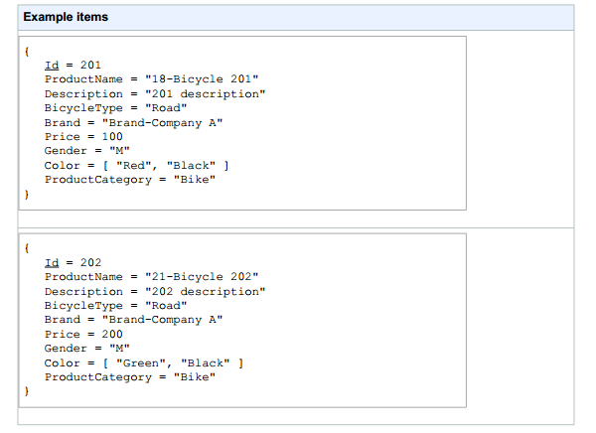
example

Slide 30
Access methods
Amazon DynamoDB is a web service that uses HTTP and HTTPS as the transport method
JavaScript Object Notation (JSON) as a message serialization format
APIs
  Java, PHP, .Net
  Boto

Slide 31
Simple Queue Service
Store messages traveling between computers
Make it easy to build automated workflows
Implemented as a web service
  read/add messages easily
Scalable to millions of messages a day

Slide 32
Some features
Message body : <8Kb in any format
Message is retained in queues for up to 4days
Messages can be sent and read simultaneously
  Can be “locked”, keeping from simultaneous processing
Accessible with SOAP/REST
  Simple: Only a few methods
Secure sharing

Slide 33
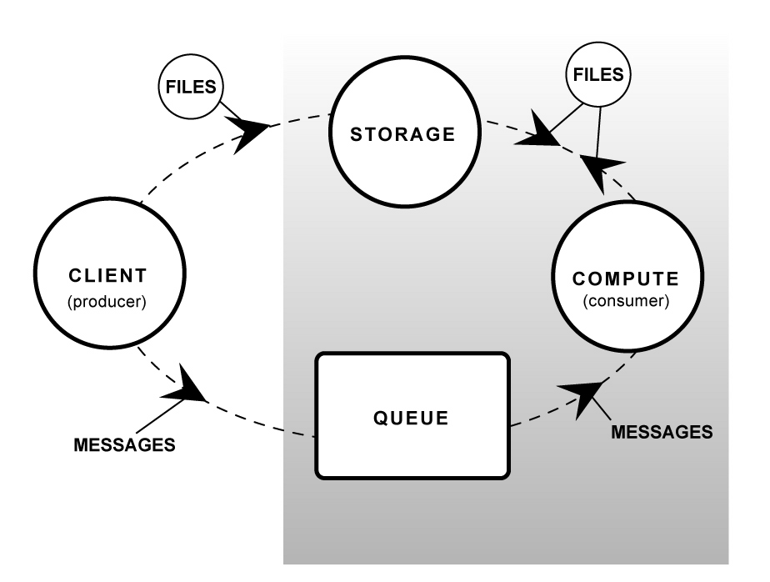
A typical workflow

Slide 34
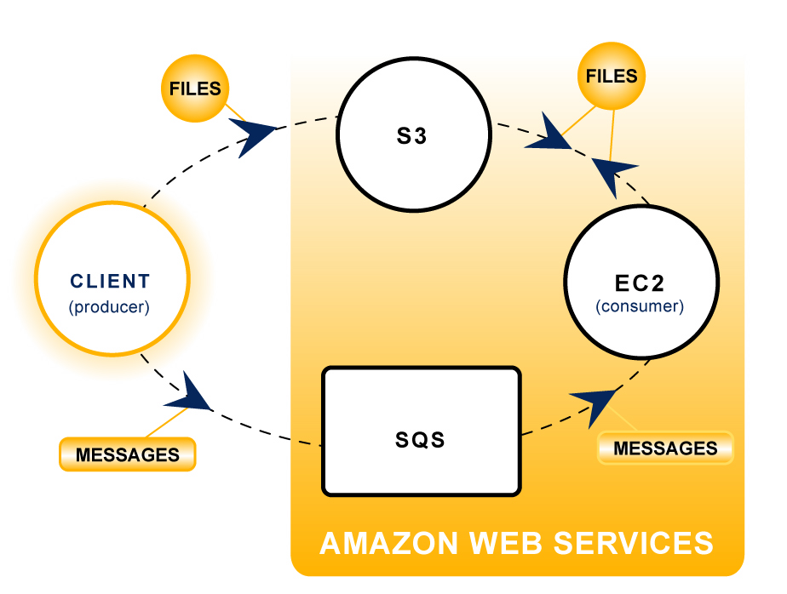
Workflow with AWS

Slide 35
Summary
AWS is the most popular IaaS
  You can use AWS to construct a computing workflow
    Computing nodes
    Storages
    Message passing

